Slide 1
Serverless with Azure

Slide 2
Where did all the Servers go?
And who are these people with slides?

Slide 3




About Us
Elizabeth Graham
Global Black Belt Azure Architect
Based in Indianapolis, IN
Elizabeth.Graham@microsoft.com
@esgraham13
David Barkol
Global Black Belt Azure Architect
Based in Irvine, CA
dabarkol@microsoft.com
@dbarkol
@azureninjas
#azureserverlesstour
aka.ms/serverlesscontent

Slide 4


About Us
Pete Roden
Global Black Belt Azure Architect
Based in Cincinnati, OH
Pete.Roden@microsoft.com
@peteroden
Sasha Rosenbaum
Global Black Belt Azure Architect
Based in Chicago, IL
Sasha.Rosenbaum@microsoft.com
@DivineOps
@azureninjas
#azureserverlesstour
aka.ms/serverlesscontent

Slide 5
About Us
Pete Roden
Global Black Belt Azure Architect
Based in Cincinnati, OH
David Barkol
Global Black Belt Azure Architect
Based in Irvine, CA
dabarkol@microsoft.com
@dbarkol
Pete Roden
Global Black Belt Azure Architect
Based in Cincinnati, OH
Pete.Roden@microsoft.com
@peteroden
@azureninjas
#azureserverlesstour
aka.ms/serverlesscontent

Slide 6
About Us
Elizabeth Graham
Global Black Belt Azure Architect
Based in Indianapolis, IN
Elizabeth.Graham@microsoft.com
@esgraham13
@esgraham13
Sasha Rosenbaum
Global Black Belt Azure Architect
Based in Chicago, IL
Sasha.Rosenbaum@microsoft.com
@DivineOps
@azureninjas
#azureserverlesstour
aka.ms/serverlesscontent

Slide 7
About Us
Elizabeth Graham
Global Black Belt Azure Architect
Based in Indianapolis, IN
Elizabeth.Graham@microsoft.com
@esgraham13
Pete Roden
Global Black Belt Azure Architect
Based in Cincinnati, OH
Pete.Roden@microsoft.com
@peteroden
@azureninjas
#azureserverlesstour
aka.ms/serverlesscontent

Slide 8
The future is Serverless
How do I architect my app to become Serverless?
Notes:
Talking points: (New)
What do we go from here?
Introducing Serverless, an event-driven process, which will grow and scale on demand.
The only remaining question now becomes: How I architect my app to become Serverless? Pretty neat, right?
It all sounds great, naturally, you may ask, how does Serverless fit into the picture?

Slide 9
What is Serverless?
$
Abstraction of servers
Event-driven/ instant scale
Micro-billing
Notes:
Abstraction of servers, infrastructure and configuration of operating system
Event-driven scale
Sub-second billing
Stateless
Serverless compute is a fully managed service. Some refer to it as Functions as a Service
OS and Framework patching is performed for you
There is zero administrative tasks and no need to manage any infrastructure
You just deploy your code (function) and it runs
Your code runs within seconds and for very short period of time
Serverless compute scales quickly (almost instantly) and vastly
Automatically scales within seconds
No scale configuration is required (there is no way to configure scale or limits)
Scales to match any given workload. Scales from zero to handle tens of thousands concurrent functions invocations within seconds
Pay only for the time your code is running
Serverless compute reacts to events
React, in near real-time, to events and triggers
Triggered by virtually any event from Azure service or 3rd party services
Setup time, provisioning is long & costly

Slide 10
Benefits of Serverless
Reduced DevOps
Manage apps not servers
Faster time to market
Notes:
“Pinnacle of PaaS compute”
Not just hardware “servers”, but software servers are also managed for you
Focus on business logic, not solving technical problems not core to business
Lower effort to get started makes it easier to experiment (bots, etc.)
Benefits of “Serverless”

Slide 11



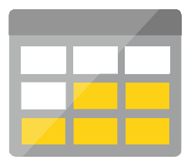




Serverless application platform components
Development
Platform
IDE support
Event Grid
Logic Apps
Functions
Manage all events that can trigger code or logic
Design workflows and orchestrate processes
Execute your code based on events you specify
Integrated DevOps
Local Development
Monitoring
Database
Storage
Security
IoT
Analytics
Intelligence
Visual Debug History

Slide 12
Serverless application platform components
Development
Platform
IDE support
Functions
Logic apps
Event Grid
Integrated DevOps
Developer productivity
Visual designer
Manage all events in one place
Triggers and Bindings
100+ connectors
Near real-time delivery
Local development
Flexible deployment options
Functions orchestration
Broad coverage
Monitoring
Database
Storage
Security & Access Control
IoT
Analytics
Intelligence
Visual Debug History

Slide 13


Introducing Functions
Code
Azure Functions
Events + data

Slide 14
How is serverless development different
Mono-lithic application
Inside client app
Complex framework
Loosely coupled components
Outside client app
Micro-functionality
Notes:
Mono-lithic application -> loosely coupled components
Events happening async outside client application
Build/use micro-functionality to react to a single event

Slide 15
Key Indicators for Serverless

Slide 16
Key Indicators for Serverless
Stateless and scale
Not worth deploying a traditional backend
Workload is sporadic (high volatility of demand)
Dev ops favored versus dedicated ops
Lots of different services that need “glue”

Slide 17
Serverless scenarios: anything that responds to events
Timer-based processing
Real-time stream processing
Every 15 minutes
Find and clean invalid data
Clean table
Millions of devices feed into Stream Analytics
Transform to structured data
Store data in SQL DB
Mobile app backends
Real-time bot messaging
?
...
Photo taken and WebHook called
Stores in blob storage
Produces scaled images
Message sent to Chatbot
Chatbot sends
response
Cortana Analytics answers questions

Slide 18
Hands on Lab: Functions

Slide 19
Patterns to Follow
Keep execution short and return quickly
Decouple tasks
Compile and or pack to optimize cold start times
Notes:
Similar to microservice patterns (12 factor)

Slide 20
Serverless scenarios:
Timer-based processing
Every 15 minutes
Find and clean invalid data
Clean table

Slide 21
Serverless scenarios:
Real-time stream processing
Millions of devices feed into Stream Analytics
Transform to structured data
Store data in SQL DB

Slide 22
Serverless scenarios:
Mobile app backends
Photo taken and WebHook called
Stores in blob storage
Produces scaled images

Slide 23
Serverless scenarios:
Real-time bot messaging
?
...
Message sent to Chatbot
Chatbot sends
response
Cortana Analytics answers questions

Slide 24
New Visual Studio 2017 tooling
Based on class libraries
Get the full power of IntelliSense, unit testing, and local debugging
Use WebJobs attributes to define triggers and bindings
Learn more at https://aka.ms/2017functiontools

Slide 25
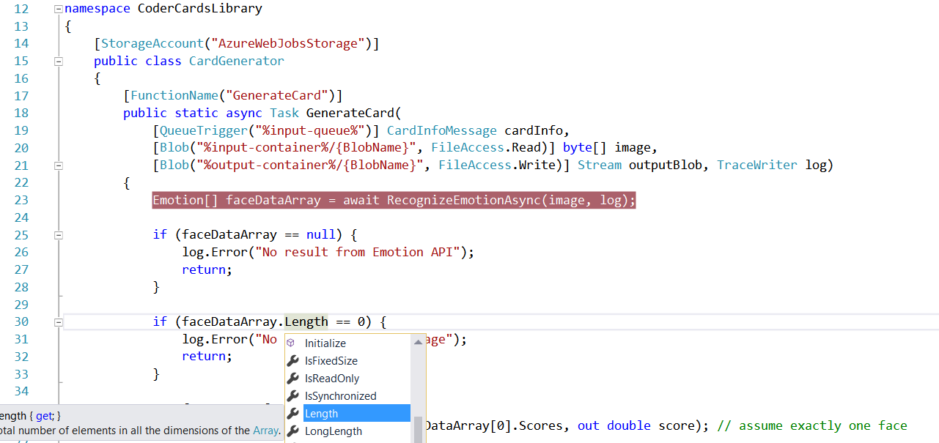
Visual Studio 2017 Tooling

Slide 26
Platform and scaling
App Service offers dedicated and dynamic tiers.
Dedicated is the existing App Service plan tiers
Basic, Standard, Premium
Pay based on # of reserved VMs
You’re responsible for scale
Dynamic
Pay on number of executions
Platform responsible for scale

Slide 27
Dynamic tier pricing
Pay per execution model - two meters, three units
Number of executions
Duration of execution x reserved memory
First million executions free.

Slide 28

What’s new in Azure Functions
Trigger a function based on changes in Cosmos DB
Database
Local Development
Develop functions locally on Linux, MacOS, Windows
Functions
Durable Functions
Long running, stateful functions
Securely provide access to information in Microsoft Graph through a function
Security
Execute your code based on events you specify
Monitoring
Monitor serverless applications using Application Insights
Trigger a function from a real-time analytics pipeline in Stream Analytics
Analytics

Slide 29


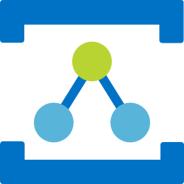

Azure Messaging Services
Service Bus
Event Hubs
Relay
Event Grid
Asynchronous enterprise messaging
Distributed data streaming
Secure two way communication without changes to your network
Cross cloud reactive eventing
Notes:
When we look at what we have in Azure today for messaging services, we have many options. Some of them include:
Service Bus – a messaging platform for the enterprise, similar to MSMQ or Tibco for those who are familiar with those offerings.
Event Hubs – a distributed data streaming platform. Very similar to Kafka
Relay – a service that facilitates hybrid applications by securing two-way communication within a corporate network and Azure. This is actually one of the oldest services in Azure.
Event Grid - a messaging platform that is intended to bring events to the cloud, just like what we are accustomed to with operating systems and user interfaces.
A common question is “why do we have all these different services?”. The answer is that each one is designed to support a specific type of messaging task. This is by design instead of trying to make one service do many things, which in some cases might end up being unnatural.

Slide 30
Azure Event Grid
Fully-managed event routing
Near real-time event delivery at scale
Broad coverage within Azure and beyond
Backbone of event-driven computing
Notes:
If you’ve done any UI work in the past, you might be familiar with delegates and event-driven programming. This has been a solved problem for a long time within application, now it is finally coming to the cloud.

Slide 31
Benefits
Focus on innovation and pay per event
Ensure reliability and performance for your apps
Unlock new scenarios for your apps
Manage all events in one place

Slide 32


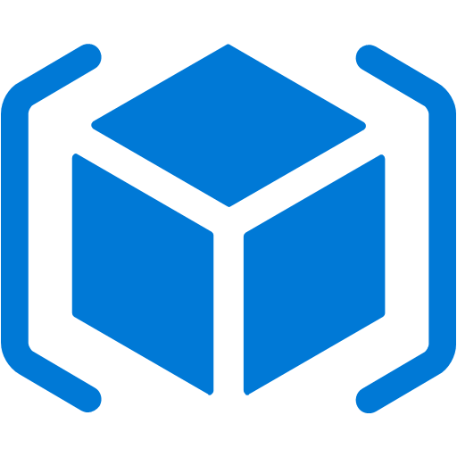

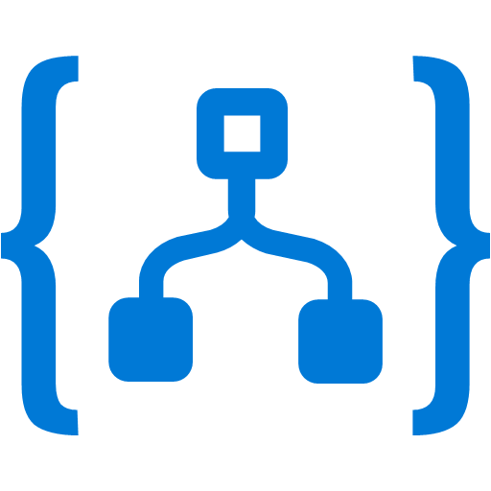


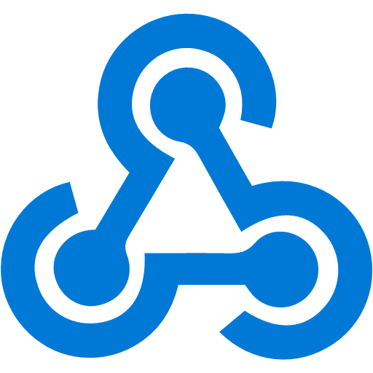

Manage all events in one place
Event publishers
Event handlers
Blob Storage
Azure Functions
Resource Groups
Logic Apps
Azure Subscriptions
Azure Automation
Event Hubs
WebHooks
Custom Events
Notes:
It comes down to having a collection of event publishers and event handlers.

Slide 33
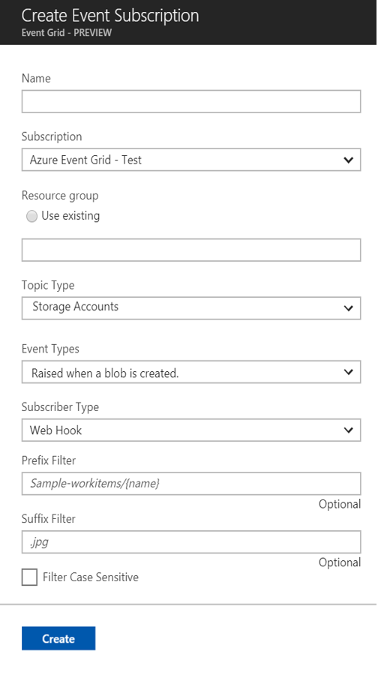
Manage all events in one place
Event publishers
Event handlers
Subscribe to pre-defined system events in Azure or create your own custom topics
Route events to any end-points, Azure or even beyond
Enable filtering and efficient routing of events
Notes:
This is a simplified view of what managing events looks like.

Slide 34
Ensure reliability and performance in your apps
Sub-second end-to-end latency in the 99th percentile
10,000,000 events per second per region
24-hour retry with exponential back off for events not delivered
Near real-time
Massive scale-out
High reliability
Notes:
We want to deliver reliable notification in near real-time, at massive scale. It needs to be highly reliable, you should be able to create items/messages that you can’t afford to lose.

Slide 35
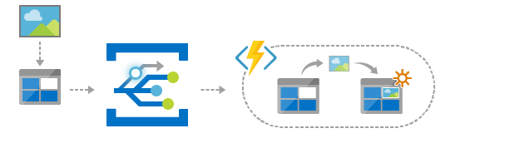
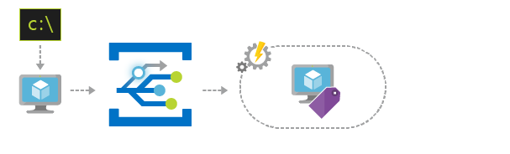
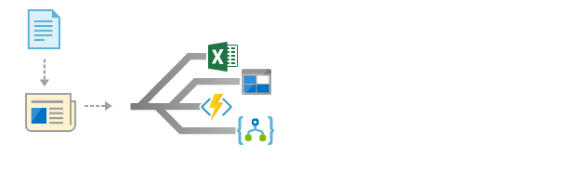
Scenarios
Serverless apps
Ops automation
Application integration
Instantly trigger a serverless function to run analysis when a new file is added to a blob storage container.
Speed up automation and simplify policy enforcement by notifying Azure Automation when underlying infrastructure is provisioned
Connects your app with other services. Create an application topic to route your app’s event data to any desired destination
Notes:
Serverless apps turns out to be one of the areas with the most impact. Event Grid can trigger many of these scenarios.
Ops automation – most people use Lambda for this and we anticipate this being used in concert with ARM.
Application integration – probably the most obvious one, integration between applications and organizations.

Slide 36
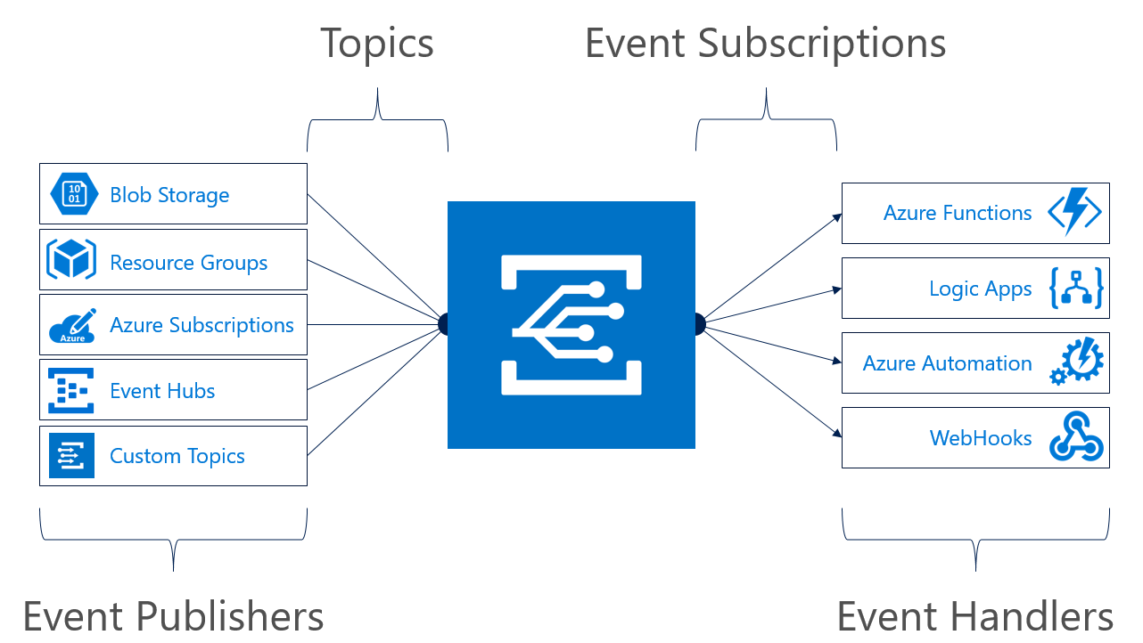
Concepts
Events: what happened
Event Publishers: where it took place
Topics: where publishers send events
Event Subscriptions: how you receive events
Event Handlers: the app or service reacting to the event
Notes:
Most topics in Event Grid are implicit unless you are using custom topics.

Slide 37
Event Grid guiding principles
Events are independent
Always available
Near real-time event delivery
At least once delivery
Dynamic scale
Platform agnostic (WebHook)
Language agnostic (HTTP protocol)

Slide 38
Target performance
Sub-second end-to-end latency in the 99th percentile
99.99% availability
10,000,000 events per second per region
100,000,000 subscriptions per region
50 ms publisher latency
24 hour retry with exponential back off for events not delivered
Transparent regional failover
Notes:
24 hour retry is the GA target, today it is just for 2 hours.

Slide 39
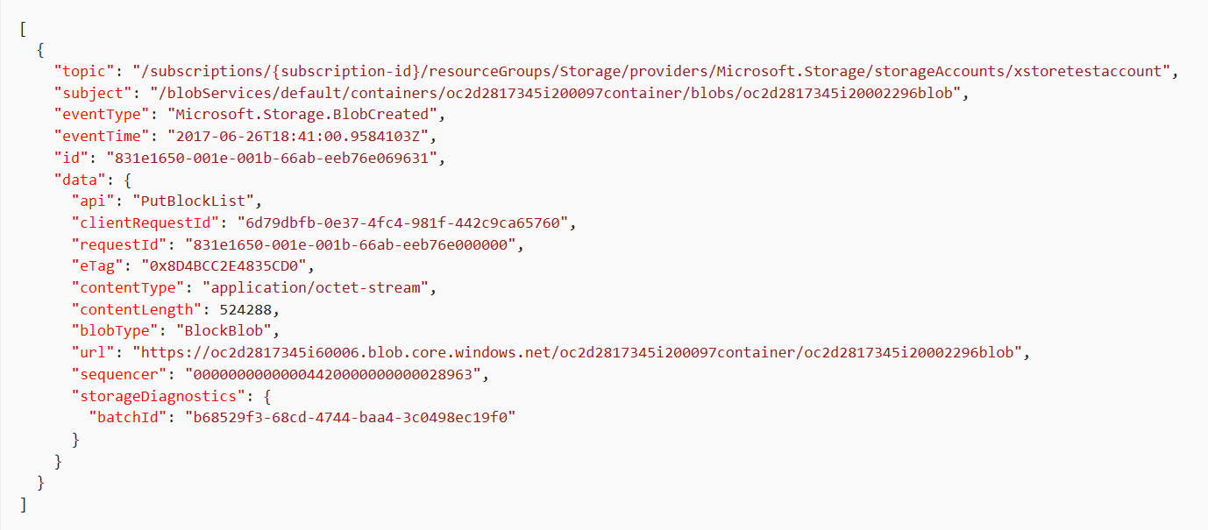
Event Schema
Notes:
This is an example of a storage event.
The data property contains contextual information about the payload from the publisher.

Slide 40

Resource model: extension resource
ARM calls are made to a parent resource
ARM reroutes all Event Grid calls to the Event Grid RP
Notes:
When you are interacting with Event Grid, you are actually communicating with an extension of the resource provider for that service.

Slide 41
Demo

Slide 42
Why does this all matter anyway?
Loosely coupled
Using the right tool for the right task
Knowing the difference between Events and Telemetry / streams

Slide 43
Learn more at azure.com/EventGrid

Slide 44
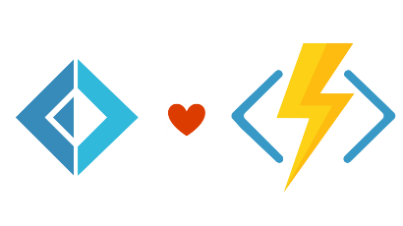


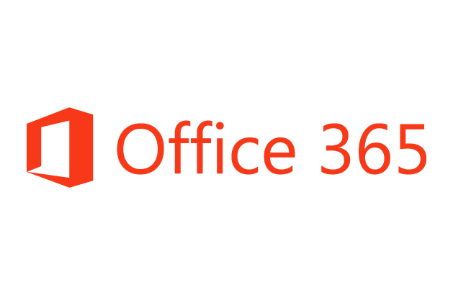
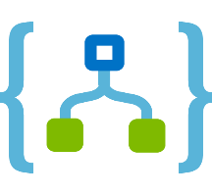

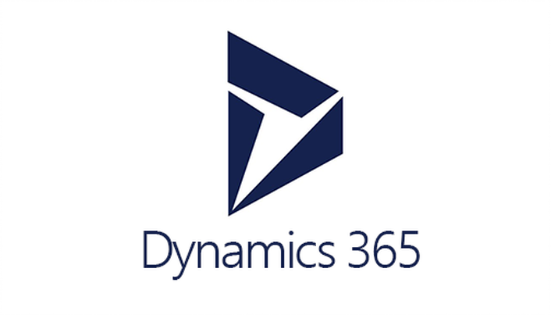



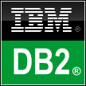



Logic Apps connects everything
Azure Functions
Service bus
Cognitive services
Logic Apps
Machine learning
On-premises data gateway
BizTalk server
Notes:
Logic Apps can integrate with “anything” (APIs) and solve small or complex problems. Automation in a secure and reliable environment fast and easy.
Connect Anything:
On-premises, hybrid and cloud
Mission critical, complex integration scenarios
Business productivity
Agile Business:
Quickly create workflows
Position to the future API centric
Transform Business:
Extract value from both (on-premises and cloud apps)
Build Holistic integration solutions.

Slide 45
Everything? Really?
Okay, not everything. But there are 200 connectors and in
preview is the ability to create custom connectors. And with
Event Grid, we have many more options as well.

Slide 46
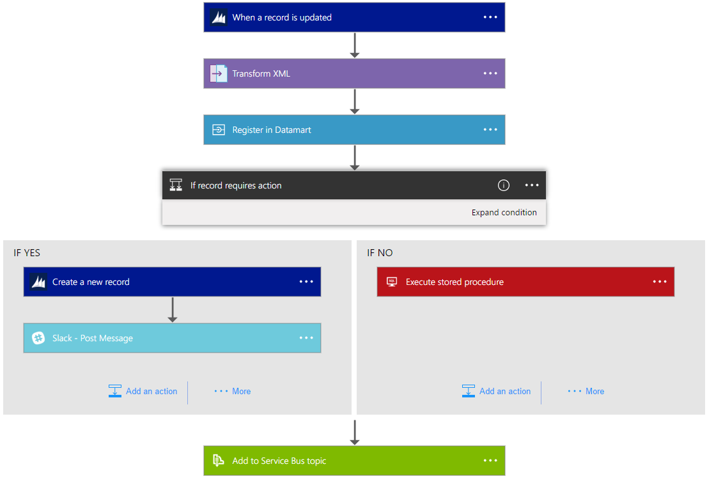
Logic Apps Workflow Designer
Workflow in the cloud
Powerful control flow
Connect disparate applications
No code designer for rapid creation
Also works within Visual Studio for added CI/CD

Slide 47
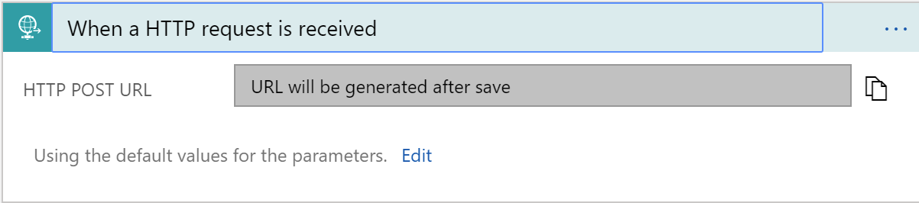
Triggers
All logic apps start with a trigger, typically a connector
Recurring and Adv. Scheduling
Polling
Webhook
Request

Slide 48
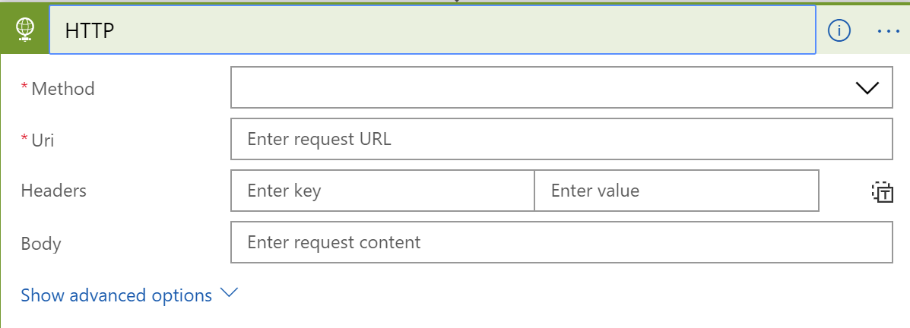
Actions
All logic apps continue with actions, which is also most of the time, a connector
Invoke APIs and Services
Behaviors
Variables
Expressions and Operators

Slide 49
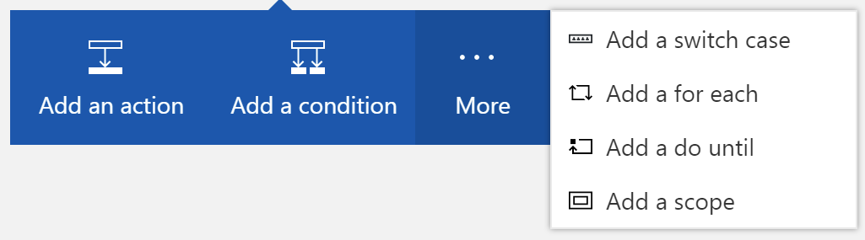
Workflow Features
To control your logic app's workflow, you can specify different paths for your logic app to run and how to process data in arrays, collections, and batches

Slide 50
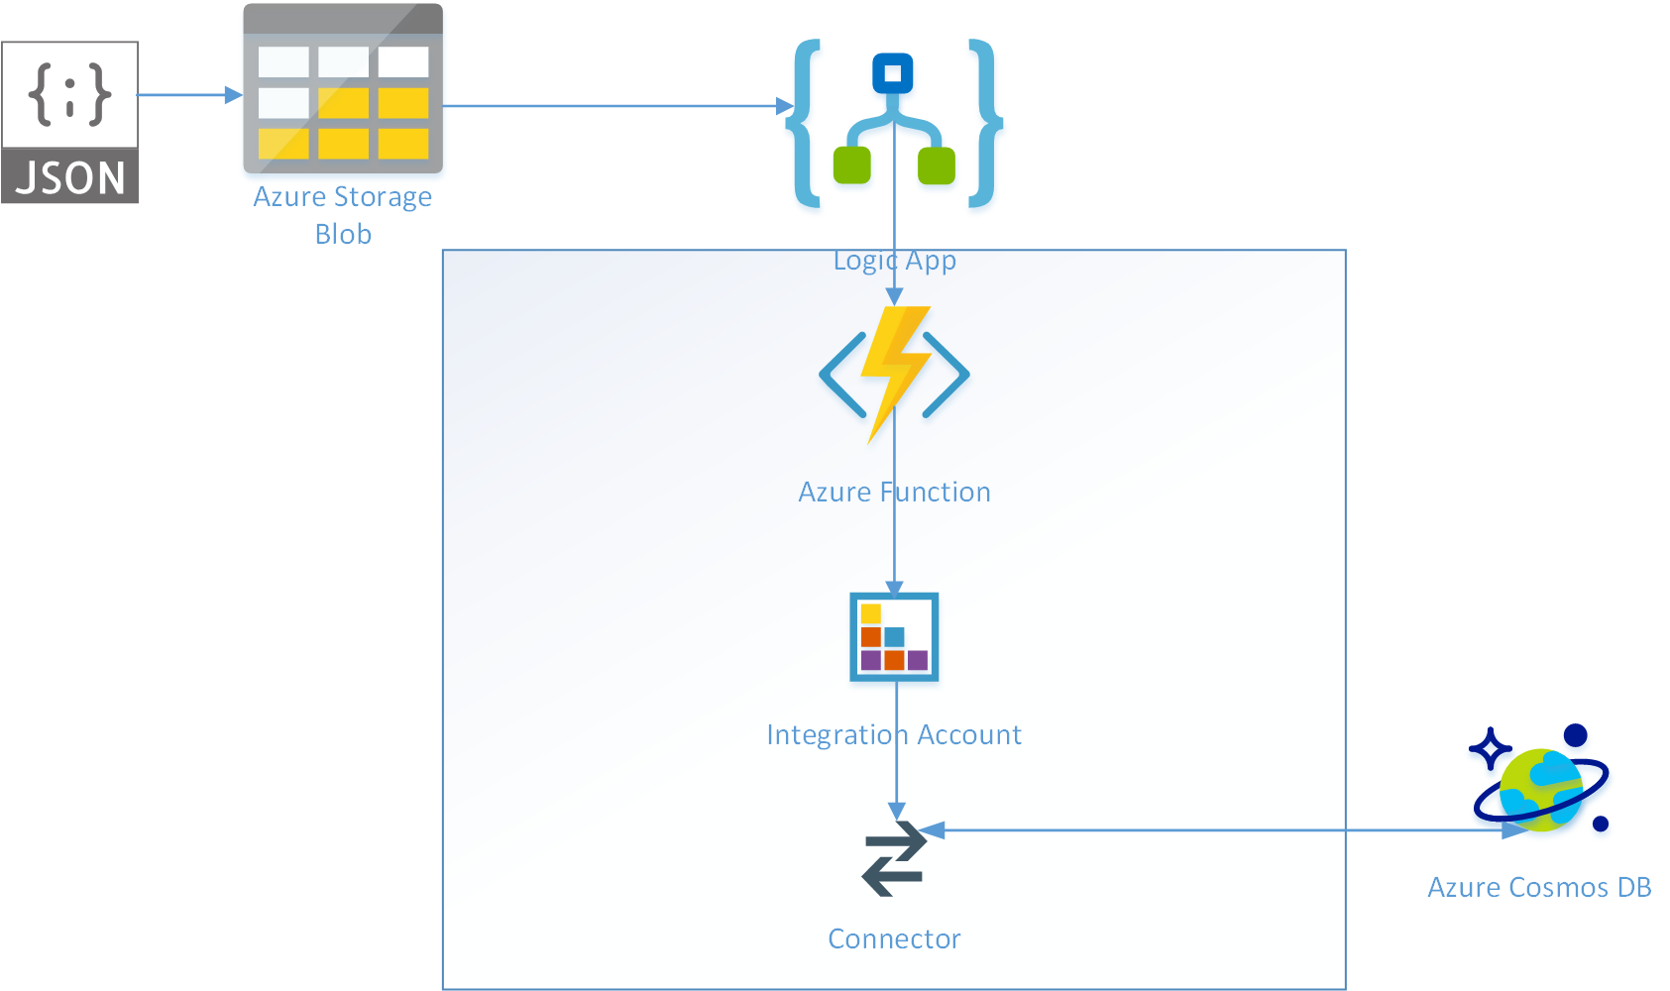
Logic Apps Demo
Notes:
TIME MARKER: 10:40 A.M.

Slide 51
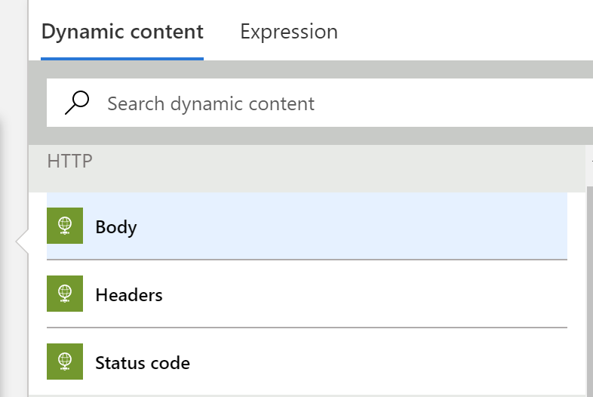
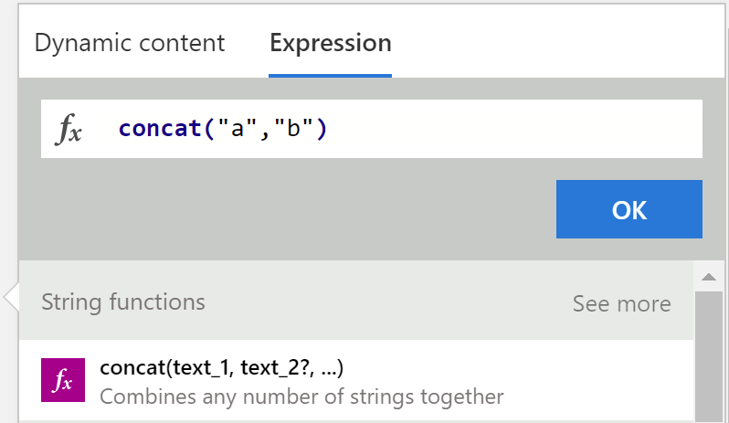
Tips and Tricks
Dynamic Content
Expressions

Slide 52
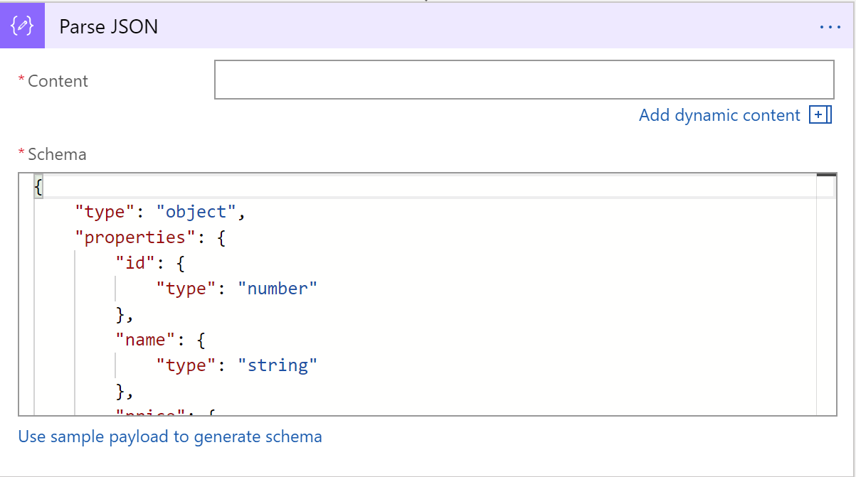
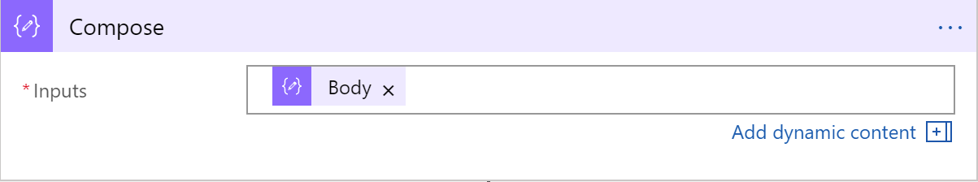
Tips and Tricks
Common shapes that will be used
Parse JSON
Compose
Notes:
Parse JSON – take a JSON object and convert to a specified schema
- constructing any output, including objects, arrays, and any other type natively supported by logic apps

Slide 53
Workflow Patterns

Slide 54
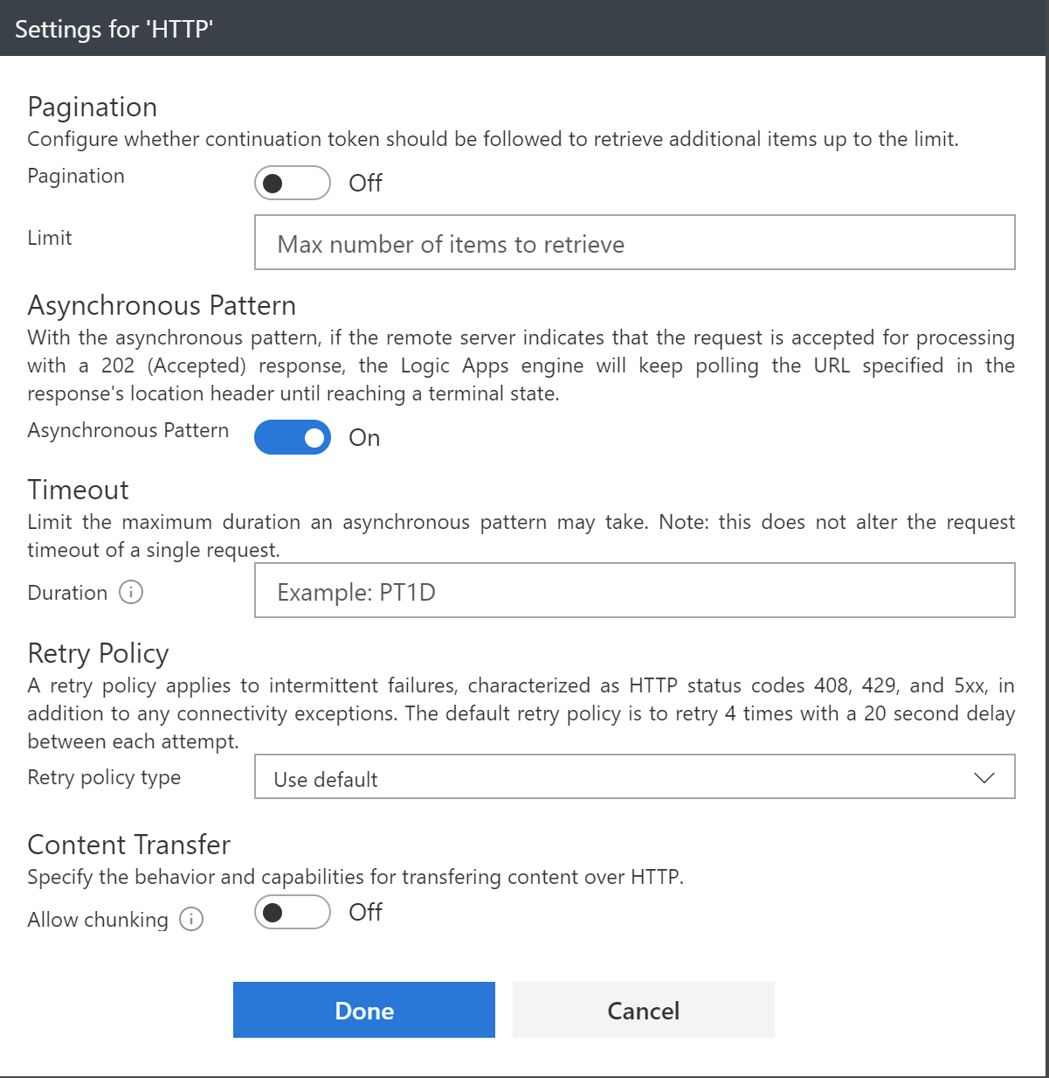
Error Handling
Notes:
Retry policy
Default, custom, and disabled
Run After
Conditional dependency control
Status: Succeeded, Failed, TimedOut, Skipped
Terminate
Early termination
Failed or Successful status
Scopes
Encapsulate a set of actions
Status: Determined by the status of the leaf nodes within the Scope
Succeeded: all must have succeeded
Skipped: all must have been skipped
Failed: any not succeeded or skipped

Slide 55
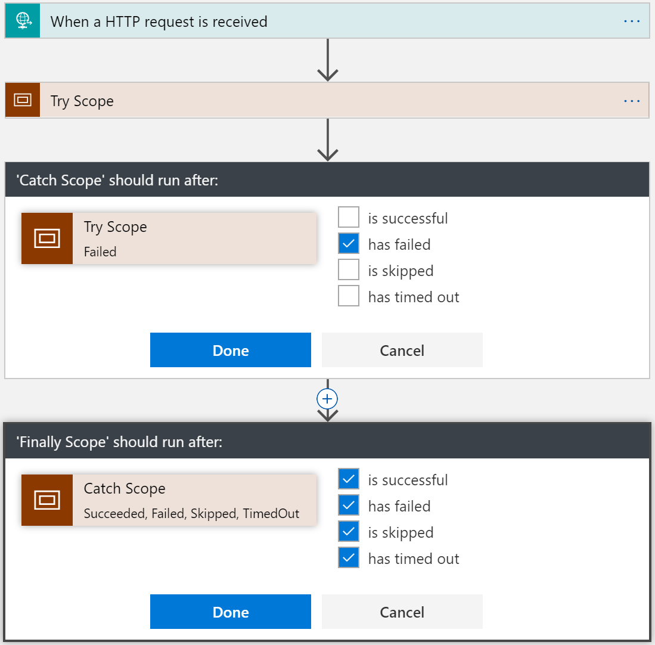
Try-Catch-Finally Pattern
Try
Put actions in a Try scope
Catch
Run after Try scope Failed
Finally
Run after Catch scope Succeeded, Skipped, TimedOut, or Failed
Notes:
Scopes
Encapsulate a set of actions
Status: Determined by the status of the leaf nodes within the Scope
Succeeded: all must have succeeded
Skipped: all must have been skipped
Failed: any not succeeded or skipped

Slide 56
Long Running Processing
Until Condition is met
Do-until loop
Evaluated condition, total time, or count
When a Timeout has occurred
Configure timeout action setting
While other work is being done
Parallel actions

Slide 57
Concurrency Control
Runs
Instances are created concurrently
Singleton trigger executions
Degrees of parallel execution
Only for non split-on polling triggers
For Each Loops
Collections handled concurrently
Sequential For Each
For each degrees of parallelism
Parallel actions
Explicit parallelization
Join with Run After
Do Until Loops
Runs sequentially

Slide 58
Scheduling executions
Example workloads
Cleanup jobs, data synchronization, running reports, data compression
Simple Recurrence
Every 5 minutes, every 2 days
Recurrence with deterministic time
Use start time
Every hour on the hour, every day at midnight
Complex schedules
Every Sunday at noon, every 15 minutes during work hours
Run once jobs
Show pattern (next slide)

Slide 59
Advanced scheduling
// Occur on the last Friday of every month at 8:30am and 5:30pm
"triggers": {
"Recurrence":
"recurrence":
{
“startTime": "2017-11-01T15:30:30Z",
"frequency": "month",
"interval": 1,
"schedule":
{
"minutes": [30],
"hours": [8,17],
"monthlyOccurrences":
[
{"day": "friday", "occurrence": -1}
]
}
},
"type": "Recurrence"
}

Slide 60
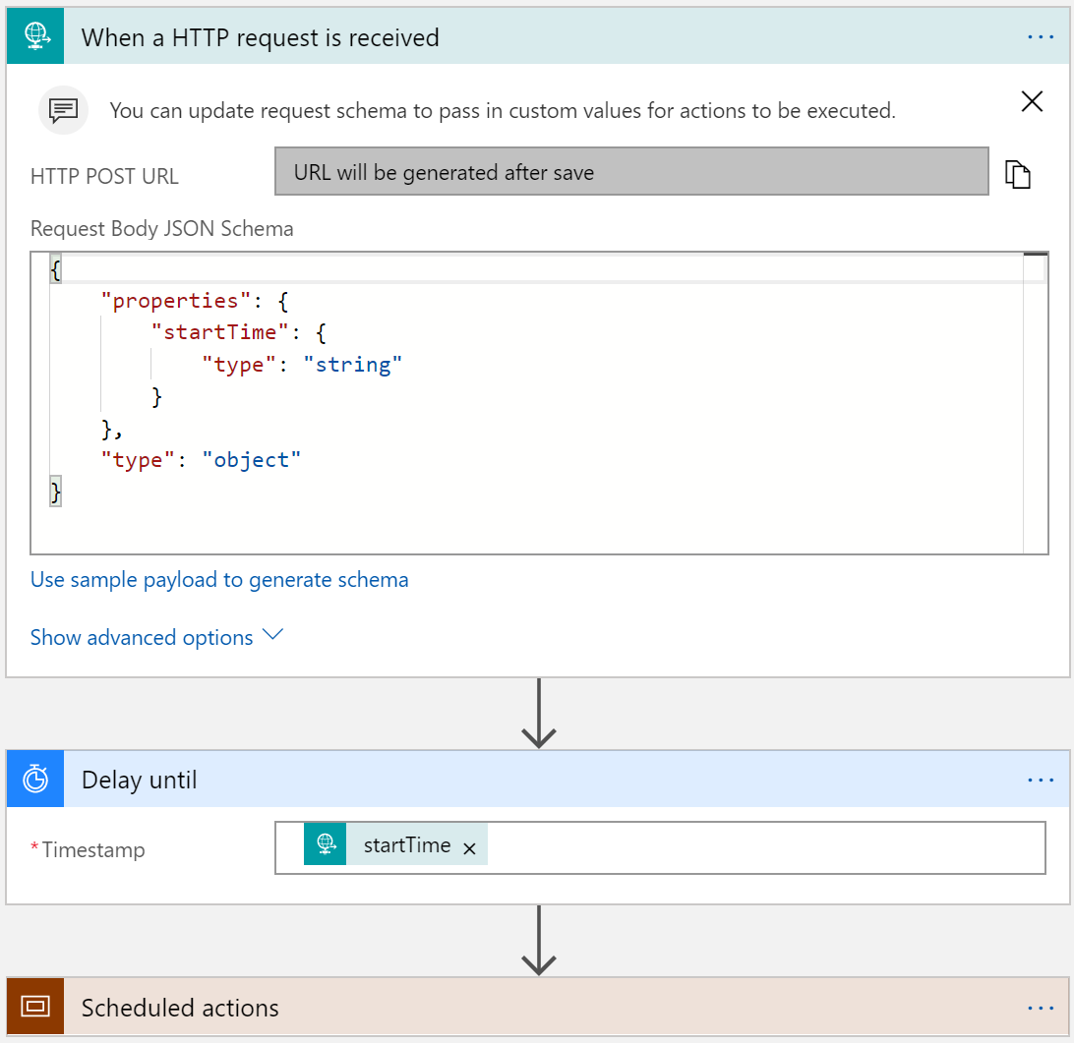
Run Once Jobs
Request trigger
Start time input
Delay Until (start time)
Instantiate millions of scheduled jobs

Slide 61

Batching
Grouping and processing messages
2 Logic Apps – sender and receiver
‘batcher’ aware of batching logic app
Batching logic app not aware of batcher(s) – 1:n
Partition within batch
Config
Event
Time based
Count Based
Size based (soon)
Batch
Trigger

Slide 62
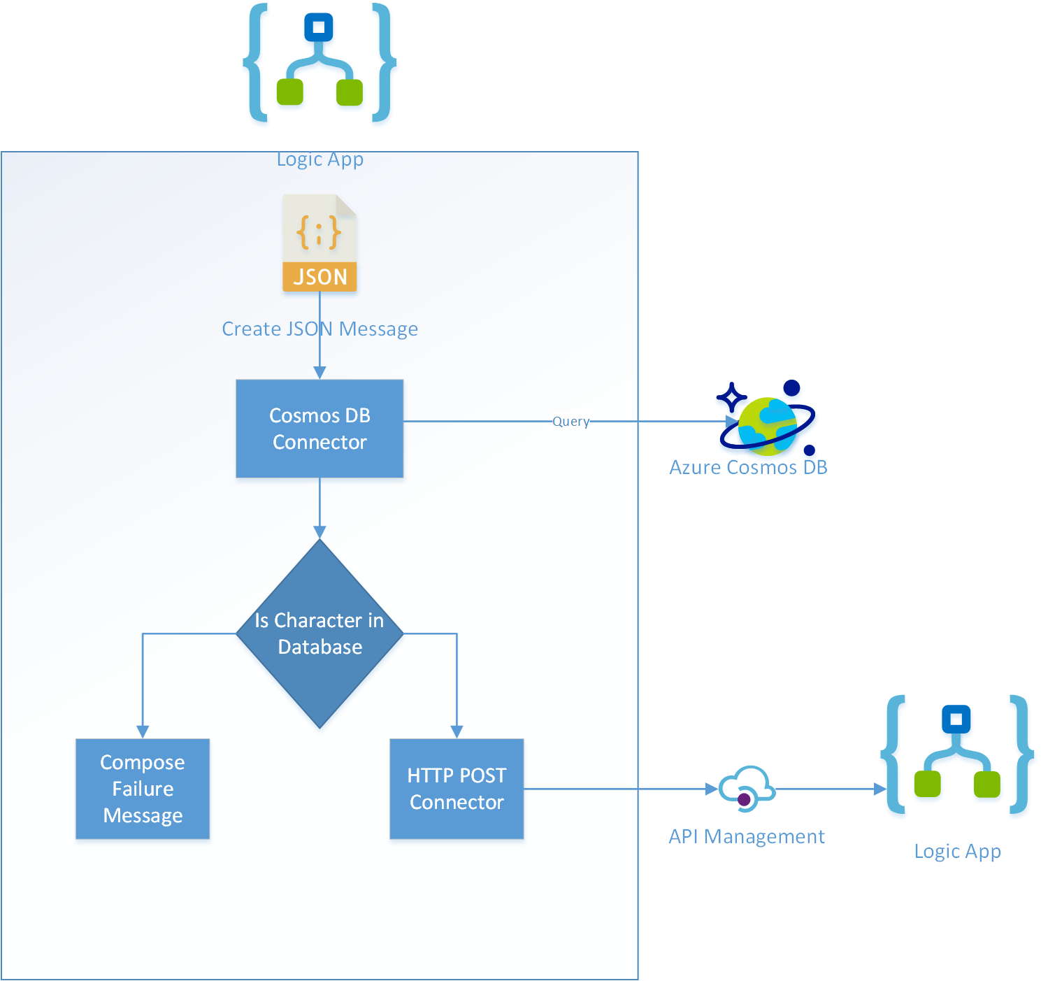
Hands on Lab: Logic Apps
https://aka.ms/LA_CheatSheet

Slide 63
Learnings
Know the Limits of Logic Apps
Consider the workflow – high throughput vs long running workflow
Understand the data structure
Leverage concurrency as much as possible
Consider side-by-side strategy for testing

Slide 64
Misconceptions and Gotchas
Not a lightweight BizTalk
Its not a silver bullet
Be aware of the workload (for loops, etc)
Management is either in the portal or Visual Studio
ALM is defined in VSTS, but has short comings
There is not much guidance – but that’s why we are here!

Slide 65
Next Steps
For you
For your Company
Visit our Github page:
aka.ms/serverlesscontent
Functions Podcast:
http://azureninjas.cloud/episode/serverless
Event Grid article
https://msdn.microsoft.com/en-us/magazine/mt829271.aspx
CodeSlinger Serverless Event {bring us 2 or 3 business problems that can be solved with serverless and we will spend 2 days with your team building out the POCs}
Email Us: serverlessninjas@microsoft.com

Slide 66

Thank You!

